Slide 1
PRECONCEPTION CARE: WHAT IT IS & WHAT IT ISN’T
MODULE 1
Reviewed and revised: October 31, 2015
Release Date: October 31, 2015
Termination Date: October 30, 2017
CME sponsored by Albert Einstein College of Medicine, New York

Slide 2
Faculty & disclosures
Faculty
Merry-K Moos, BSN, (FNP-inactive) MPH, FAAN Professor of Obstetrics & Gynecology (retired) and Consultant, Center for Maternal and Infant Health, UNC School of Medicine, Chapel Hill, NC;
Peter Bernstein, MD, MPH, FACOG Professor of Clinical Obstetrics & Gynecology and Women’s Health, Albert Einstein College of Medicine, Bronx, NY
Disclosures
Dr. Bernstein and Ms. Moos present no conflict of interest. They will not present any off-label or investigational uses of drugs/devices in this activity.

Slide 3
Target Audience
Clinicians, including physicians, nurse midwives, nurse practitioners and physician assistants, who provide primary and reproductive health care

Slide 4
Accreditation and Credit Designation Statements
Accreditation Statement—This activity has been planned and implemented in accordance with the Accreditation Council for Continuing Medical Education (ACCME) through joint providership of Albert Einstein College of Medicine and the University of North Carolina Center for Maternal & Infant Health. Albert Einstein College of Medicine is accredited by the ACCME to provide continuing medical education for physicians.
Credit Designation Statement –Albert Einstein College of Medicine designates this internet enduring material for a maximum of 1.0 AMA PRA Category 1 Credit™. Physicians and others should claim only credit commensurate with the extent of their participation in the activity.

Slide 5
To Fully benefit from this CME Opportunity Follow these Simple Steps:
Download file to PC (this will allow you to review content as you have time);
You will need to view the power point presentation in slide show mode for the features and links to work;
Where they appear, use the arrows at the bottom of slides to advance through the content;
At the conclusion of the content there will be instructions and a link for obtaining your Category 1 CME.

Slide 6
Learning objectives
After participating in this activity, you should be able to:
Explain the rationale for changing the perinatal prevention paradigm to include an emphasis on preconception health
Link major threats to women’s health with major threats to pregnancy outcomes
Identify three tiers for promoting high levels of preconception wellness in populations of childbearing age.
Begin to develop strategies to view every encounter with a woman of childbearing age as an opportunity for health promotion and disease prevention through the life cycle.

Slide 7
outline
The rationale for preconception health promotion
Major milestones in the movement
What it means for providers of women’s health care
Overview of components of preconception health promotion and opportunities to learn more

Slide 8
THE RATIONALE for PRECONCEPTION HEALTH PROMOTION
Next

Slide 9
The U.S. infant mortality rate is higher than many other countries (click here for international comparisons).
Although higher percentages of women receive early prenatal care than ever before, preterm birth and low birth weight rates are persistent challenges, especially for those most severely affected (click here to see preterm and low birth weight trends) and declines in infant mortality have stalled (click here to see infant mortality trends).
Next

Slide 10
International Comparisons of
Infant Mortality Rates, 2007
(latest data as of Feb, 2013)
Rank Country Rate
1 Iceland 2.0
2 Sweden 2.5
8 Portugal 3.4
13 Austria 3.7
22 United Kingdom 4.8
24 Canada 5.1
28 United States 6.8
Back
MODs Peristats, 2009

Slide 11
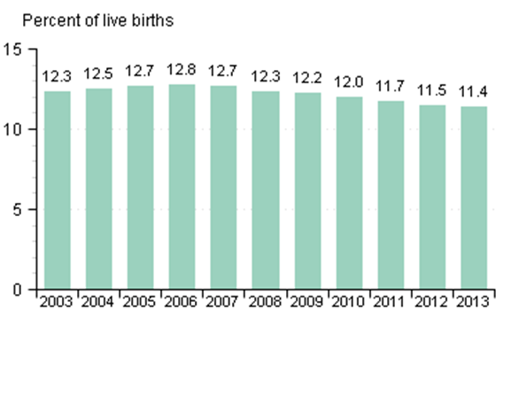
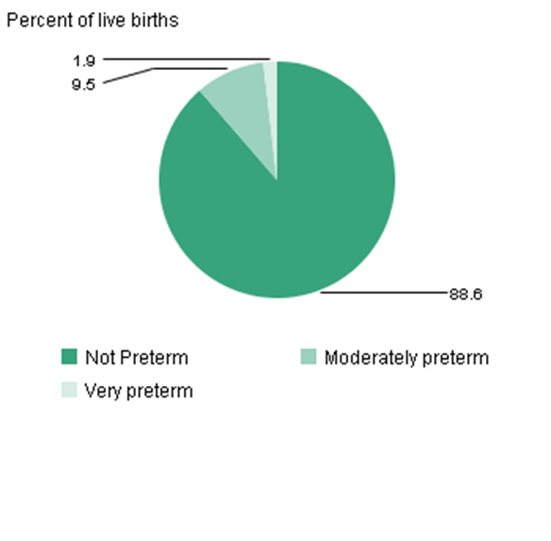
Preterm births in the U.S. 2003-2013
Preterm is less than 37 completed weeks gestation. Very preterm is less than 32 completed weeks gestation.
Moderately preterm is 32-36 completed weeks of gestation.
Source: National Center for Health Statistics, final natality data. Retrieved Mary 24, 2016 from www.marchofdimes.com/peristats.
Next

Slide 12
Preterm birth in the U.S.
In the United Stated in 2013, 1.9% of live births very premature, 9.5% were moderately preterm, and 88.6% were not preterm
Between 2000-2010, the rate of infants born preterm increased by more than 3% and from 2010-2013, the rate decreased by .6%;
Despite numerous prevention strategies, the rate of very preterm births is consistent at 2%;
The Healthy People 2020 goal for preterm births is to reduce the rate to no more than 11.4% of all live births by the end of this decade.
Back

Slide 13
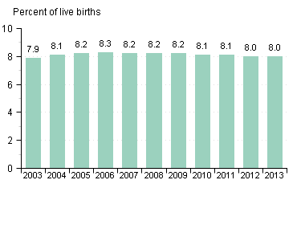
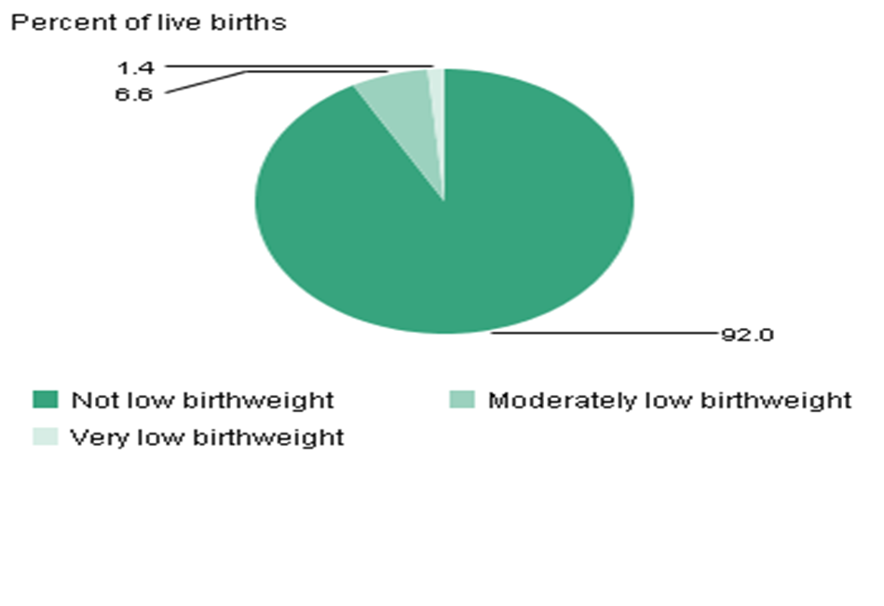
US Low Birthweight Deliveries 2003-2013
Distribution of gestational age categories: United States, 2013
Low birthweight is less than 2500 grams (5 1/2 pounds). Very low birthweight is less than 1500 grams (3 1/3 pounds). Moderately low birthweight is 1500-2499 grams.
Source: National Center for Health Statistics, final data. Retrieved May 24, 2016, from www.marchofdimes.org/peristats.
.
Next

Slide 14
Low birth weight in the U.S.
In 2013, 1 in 13 babies (8 %) was born weighing less than 2500 gms. Low birth weight affected approximately 315,099 infants;
Between 2000 and 2010, the rate of infants born low birth weight in the United States increased more than 6% and from 2010-2013, the rate decreased by .1%;
The Healthy People 2020 goal for low birth is to reduce the rate to 7.8% of live births by the end of this decade.
Back

Slide 15
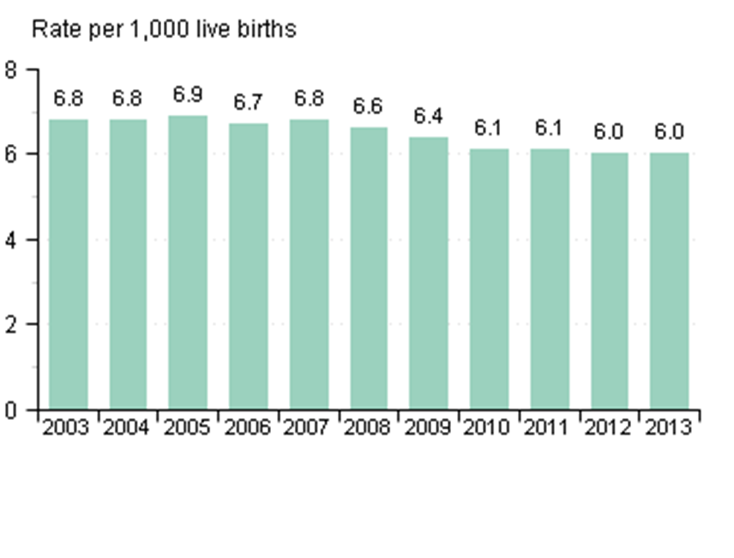
Infant Mortality Rates in the U.S. 2003-2013
An infant death occurs within the first year of life.
National Center for Health Statistics, final mortality data, 1990-1994 and period linked birth/infant death data, 1995-present.
Retrieved May 24, 2016, from www.marchofdimes.org/peristats
Next

Slide 16
Infant mortality rates in the U.S.
In 2013, the infant mortality rate was 6.0 deaths per 1,000 live births. Approximately 23,446 babies born that year died before their first birthday.
Between 1999 and 2009, the infant mortality rate in the United States declined more than 8%.
Leading causes of infant mortality are birth defects, prematurity/LBW and SIDS
Back

Slide 17
How Does Your State Compare?
Peristats is an interactive program hosted by the March of Dimes Birth Defects Foundation to help clinicians and policy makers understand trends and comparisons regarding major maternal and child health indicators.
Using Peristats can help you develop an appreciation of your own locale, produce handouts and slides and stay up to date.
Click to go to www.marchofdimes.com/peristats to learn more about the U.S. and your own state
Next

Slide 18
Incidence of Adverse Pregnancy Outcomes, most recent years
Spontaneous Abortion | 20% (estimated average)
Infant Mortality | 6/1000 live births (2013)
Fetal Mortality | 6.2/1000 live births plus fetal deaths (2005)
Major Birth Defects | 3.3% (2002)
Low Birth Weight | 8% (2013)
Preterm Delivery | 11.4% (2013)
Complications of Pregnancy | 30.7% (CDC data, 2002)
Unintended Pregnancies | 45% (2011)
Unintended Births | 31% (2006)
Next

Slide 19
The preconception movement is based on the realization that:
Prenatal care starts too late to prevent many of these poor pregnancy outcomes
Women who have higher levels of health before pregnancy have healthier reproductive outcomes
Next

Slide 20
In obstetrics, many of our outcomes or their determinants are present before we ever meet our patients
Next

Slide 21
Important Examples of Determinants
Intendedness of conception
Interpregnancy interval
Maternal age
Exposure ART/ovulation stimulation
Spontaneous abortion
Abnormal placentation
Chronic disease control
Congenital anomalies
Timing of entry into prenatal care
Next

Slide 22
Critical Events Before Prenatal Care Begins
Placental implantation begins 5 days after fertilization and is complete by days 9-10—before most women know they are pregnant.
The most critical period for development of structural anomalies is days 17-56 after fertilization; another way to say this is that organogenesis begins just 3 days after the first missed menses—before most women can get into prenatal care. The red bars on the next slide illustrate the critical periods of structural development for many organs; the yellow bars indicate the periods of functional development.
Next

Slide 23
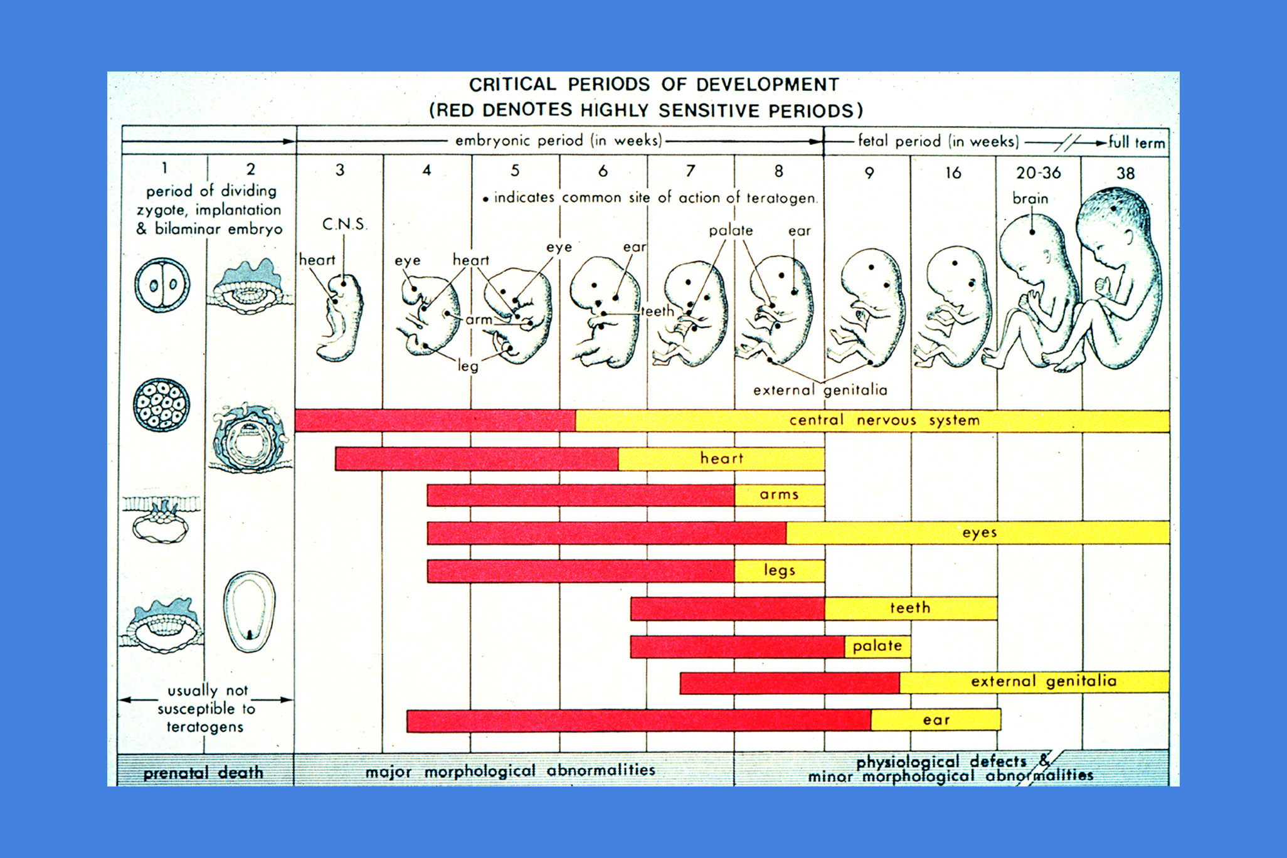
Next

Slide 24
A Critical Period for the Prevention of Poor Pregnancy Outcomes Has Already Passed by the First Prenatal Visit
Next

Slide 25
Examples of Primary Prevention Opportunities: Congenital Anomalies
The Opportunity: | The Potential Benefit:
Prevention of neural tube defects | 50-70% can be prevented if a woman has adequate levels of folic acid during earliest weeks of organogenesis—before she receives her prenatal vitamins
Birth Defects related to poor glycemic control of mother (including sacral agenesis, cardiac defects and neural tube defects) | Can be reduced from ~10% to 2-3% through glycemic control of the woman before organogenesis
Next

Slide 26
Examples of Primary Prevention Opportunities: Congenital Anomalies
The Opportunity: | The Potential Benefit:
Minimize a prospective mother’s contact with teratogenic exposures such as prescribed medications, environmental exposures and alcohol | Teratogenic substances interfere with normal organ development primarily during the period of organogenesis
Next

Slide 27
Over time, we have realized that
Preconception Health Promotion
provides a pathway to
the Primary Prevention of many poor pregnancy outcomes beyond that available through traditional prenatal care
Next

Slide 28
Preconception health promotion and health care are not new concepts; they have been gaining momentum for the last three decades
Freda, Moos & Curtis. MCHJ, 2006;10:S43
Next

Slide 29
A Brief History of the Preconception Movement
Major Milestones
Next

Slide 30
The 1980s
In 1983, the first Guidelines for Perinatal Care (joint publication of ACOG and AAP) noted:
“Preparation for parenthood should begin prior to conception. At the time of conception the couple should be in optimal physical health and emotionally prepared for parenthood”.
AAP/ACOG. Guidelines for Perinatal Care. 1983 (p257).
Next

Slide 31
The 1980s
In 1985, the report of the Institute of Medicine’s Committee to Study the Prevention of Low Birthweight emphasized the importance of prepregnancy risk identification, counseling and risk reduction.
(click here to read the Committee’s rationale for restructuring the perinatal prevention paradigm)
Next

Slide 32
IOM Committee to Study Prevention of Low Birthweight Statement
“Much of the literature about preventing low birthweight focuses on the period of pregnancy—how to improve the content of prenatal care, how to motivate women to reduce risky habits while pregnant, how to encourage women to seek out and remain in prenatal care. By contrast, little attention is given to opportunities for prevention before pregnancy. . .
Next

Slide 33
IOM Committee to Study Prevention of Low Birthweight Statement
. . .Only casual attention has been given to the proposition that one of the best protections available against low birthweight and other poor pregnancy outcomes is to have a woman actively plan for pregnancy, enter pregnancy in good health with as few risk factors as possible, and be fully informed about her reproductive and general health.”
IOM, Preventing Low Birth Weight, 1985, p 119.
Back

Slide 34
The 1980s
In 1988, two books written for clinicians highlighted the importance and opportunities of the preconception period in clinical care:
Preconception Health Promotion (Cefalo & Moos) Rockville, MD: Aspen
Medical Counseling before Pregnancy (Hollingsworth & Resnick, eds.) New York: Churchill Livingstone.
Next

Slide 35
The 1980s conclude
In 1989, the Expert Panel on the Content of Prenatal Care suggested that the preconception visit may be the single most important health care visit when viewed in the context of its effect on pregnancy. The Panel noted that preconception care is likely to be most effective when services are provided as part of general preventive care or during primary care visits for medical conditions.
Expert Panel on Prenatal Care. Caring for Our Future, 1989
Next

Slide 36
The 1990s
The March of Dimes Birth Defects Foundation, in its publication Toward Improving the Outcome of Pregnancy, the 90s and Beyond emphasized the recommendation of its Committee on Perinatal Health which stated, relative to preconception and interconception care, the following:
Next

Slide 37
Toward Improving the Outcome of Pregnancy, the 90s and Beyond
“Risk reduction should be emphasized and family planning counseling and services routinely available. Preconception or interconception visits annually, as well as a prepregnancy planning visit, should become standard components of care.”
March of Dimes Birth Defects Foundation, TIOP, 1993 p iv.
Next

Slide 38
The 1990s
Healthy People 2000, the national health promotion and disease prevention objectives for the nation, moved preconception care into a standard expectation within the health care system with the following objective:
Next

Slide 39
The 1990s
ACOG published its first technical bulletin on preconception care in 1995. In this bulletin, ACOG recommended that routine visits by women who may, at some time, become pregnant are important opportunities to emphasize the importance of prepregnancy health and habits and the advantages of planned pregnancies.
ACOG, Technical Bulletin #205, 1995
Next

Slide 40
Healthy People 2000
“Increase to at least 60% the proportion of primary care providers who provide age-appropriate preconception care and counseling.”
DHHS, Healthy People 2000, 1990 p 199
Next

Slide 41
The 2000s: The Movement Gains Momentum
In 2005, the CDC determined that:
“. . . in light of the nation’s reproductive outcomes, the time had come to ensure that efforts to improve perinatal outcomes not be limited to prenatal care (best described as anticipation and management of complications in pregnancy) . . . but be expanded to include preconception health and health care (described to include prevention and health promotion before pregnancy)”.
Atrash, et al. MCHJ 2006;10:S3
Next

Slide 42
The 2000s
In 2005, the CDC convened the Select Panel on Preconception Care comprised of specialists in obstetrics and gynecology, nursing, public health, midwifery, epidemiology, dentistry, family practice, pediatrics and other disciplines.
In the same year, CDC hosted the first National Summit on Preconception Care.
Next

Slide 43
The 2000s
In April, 2006 the CDC and the Select Panel released Recommendations to Improve Preconception Health and Health Care—United States. The recommendations were based on:
Review of published research
CDC/ASTDR Work group representing 22 CDC programs
Presentations at the National Summit on Preconception Care, 2005
Proceedings of the Select Panel on Preconception Care, 2005
Click here to access full report.
Next

Slide 44
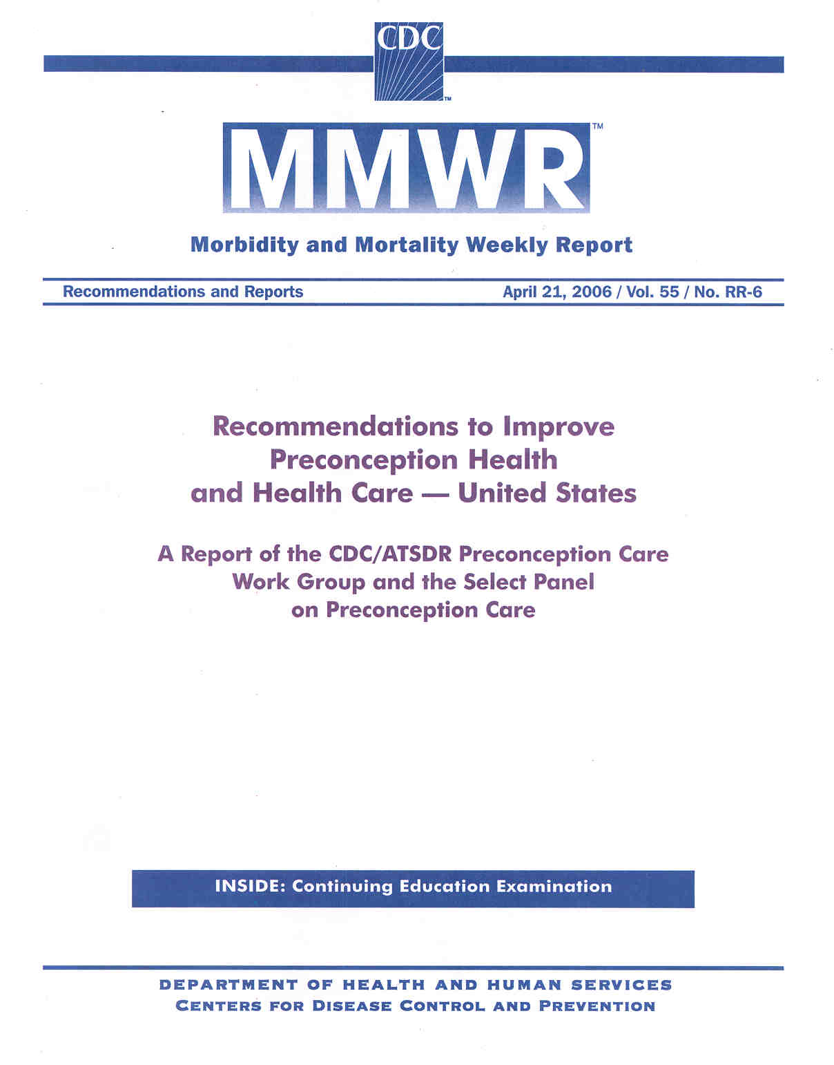
Next

Slide 45
CDC Definition of Preconception Care
Preconception care is a set of interventions that aim to identify and modify biomedical, behavioral and social risks to a woman’s health or pregnancy outcome through prevention and management. CDC and Select Panel, 2006
Because it is about achieving a high level of wellness irrespective of whether women hope or plan to become pregnant, it is about more than reproductive health: it is women’s health.
Next

Slide 46
Related Vocabulary
Preconception:
Health status and risks before pregnancy. The focus extends to men, too.
Periconception:
Immediately before conception through organogenesis
Interconception:
Period between pregnancies
Next

Slide 47
CDC Preconception Care Framework
Vision
Improve health
and pregnancy
outcomes
Goals
Coverage – Risk Reduction
Empowerment – Disparity Reduction
Recommendations
Individual Responsibility - Service Provision
Access – Quality – Information – Quality Assurance
Action Steps
Research – Surveillance – Clinical interventions
Financing – Marketing – Education and training
Next

Slide 48
The Preconception Health and Health Care Initiative evolved to implement the framework. The steering committee for the initiative is comprised of individuals representing government agencies, professional organizations and advocacy groups.
Next

Slide 49
The Steering Committee Divided into Five Workgroups:
Clinical
Consumer
Public Health
Public Policy
Data and Surveillance
Next

Slide 50
The 2010’s
The five workgroups have implemented many strategies to advance preconception health promotion. Some of the efforts of the clinical and consumer workgroups are described in this module; the public policy group has worked to integrate preconception strategies into the Affordable Care Act.
Next

Slide 51
Healthy People 2020
Healthy People 2020, which outlines health objectives for the nation, speaks specifically to preconception wellness. Click here to read the details and scroll down to objectives MICH-14 through MICH 17.
Next

Slide 52
The 2010’s
In 2012 a new strategic plan was created by the PCHHC Steering Committee. To access the plan, click here.
Next

Slide 53
What Is Preconception Care in the Clinical Setting?
Giving protection
Managing conditions
Avoiding exposures known to be teratogenic or otherwise harmful
Next

Slide 54
Giving Protection
Examples of giving protection:
Folic acid supplementation to protect against neural tube defects and other congenital anomalies
Examples of immunizations against infectious diseases that can impact pregnancy outcomes:
Rubella
Varicella
Hepatitis B
Next

Slide 55
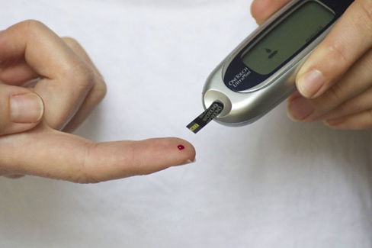
Managing Conditions
Examples of conditions known to be detrimental to reproductive outcomes if in poor control before conception:
Diabetes
Maternal PKU
Obesity
Hypothyroidism
Sexually transmitted infections
Next

Slide 56
Avoiding Exposures
Examples of exposures known to be teratogenic or otherwise harmful in early pregnancy:
Medications:
Many antiseizure medications
Oral anticoagulants
Accutane
Others
Alcohol
Tobacco
Next

Slide 57
Clinicians may well reflect: “Some of these topics are already covered in my routine well woman care—what’s the difference?”
Indeed, comprehensive well woman care is preconception care for women who may become pregnant. Some women may need more than routine well woman care but no woman needs less.
Next

Slide 58
Examining the Link between Promoting Women’s Health and Promoting Preconception Wellness
Major threats to women’s health are also major threats to reproductive outcomes.
Next

Slide 59
NUTRITIONAL STATUS: Obesity
Impact of obesity on women’s health:
Diabetes
Hypertension
Cardiovascular disease
Disabilities
Impact of maternal obesity on reproductive outcomes:
Glucose intolerance of pregnancy
Pregnancy induced hypertension
Thrombophlebitis
Infertility
Neural tube defects
Prematurity
Next

Slide 60
NUTRITIONAL STATUS: Underweight
Impact of being underweight on women’s health:
Risk of osteoporosis in later life
Fragile health status
Impact of low pregravid weight on reproductive outcomes:
Infertility
Low birth weight
Prematurity
Next

Slide 61
SUBSTANCE USE
Impact of alcohol use on women’s health:
Risk for motor vehicle and other accidents
Risk for unintended pregnancy
Risk for addiction
Risk for nutritional depletions and inadequacies
Impact of alcohol use on reproductive outcomes:
Delayed fertility
Increased SABs
Fetal alcohol spectrum disorders (full fetal alcohol syndrome can only occur with fetal exposure between days 17-56 of gestation)
Next

Slide 62
SUBSTANCE USE
Impact of tobacco use on women’s health:
Implicated in most of the leading causes of death for women:
Heart disease (#1 cause of death)
Stroke (#2)
Lung cancer (#3)
Lung disease (#4)
Impact of tobacco use on reproductive outcomes:
Leading preventable cause of infant mortality and morbidity
Preventable cause of low birth weight and prematurity
Associated with placental abnormalities including placenta previa and placenta abruptio
Next

Slide 63
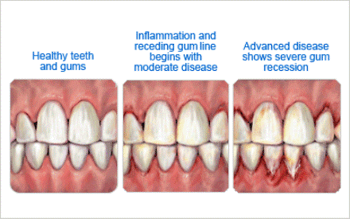
PERIODONTAL DISEASE
Impact of periodontal disease on reproductive outcomes:
Associated with higher rates preterm birth
ACOG suggests that preconception treatment trials needed to determine impact on preterm birth
ACOG CO # 569, 2013 (2015)
Impact of periodontal disease on women’s health:
Heart disease
Stroke
Dementia, respiratory diseases, osteoporosis of the oral cavity
NEXT

Slide 64
Potential Advantages of Regularly Addressing these Issues with Every Woman Who Might Someday Conceive
Higher levels of wellness for the woman
Higher levels of preconception health should a woman become pregnant
Improved pregnancy outcomes
Likely higher rates of pregnancy intendedness for those who become pregnant
Next

Slide 65
Some Thoughts on Changing the Reproductive Prevention Paradigm to Include the Preconception Period
Next

Slide 66
Three Tier Approach to Achieve Higher Levels of Well Woman/Preconception Wellness:
General Awareness (Social marketing)
Routine Health Promotion (“Every woman, Every time”)
Specialty care
These tiers are intertwined and interdependent—all three are necessary to move the agenda forward successfully and systematically
Next

Slide 67
Issues in General Awareness
The concept “preconception” means nothing to the general public
Few (professionals, patients, men, future grandmothers, etc.) understand the importance of the earliest weeks of pregnancy
Women most in need of preconception health promotion are often those least likely to have intended conceptions
Next

Slide 68
What We Need:
Need to strengthen health promotion and disease prevention initiatives for all women, irrespective of their reproductive plans.
In other words:
“Every Woman. . .Every Time”
because a woman’s health in and of itself is important.
Next

Slide 69
Warning!
What We Don’t Need. . .
A new categorical service called the
“Preconception visit”
for all women at risk for pregnancy
Next

Slide 70
For Every Woman of Childbearing Potential, Every Time She is Seen
Identify modifiable and nonmodifiable risk factors for poor health and poor pregnancy outcomes before conception
Provide timely counseling about risks and strategies to reduce the potential impact of the risks on her own health and the health of any future pregnancies
Provide risk reduction strategies consistent with best practices.
Next

Slide 71
“Every Woman, Every Time” is Opportunistic Care
Takes advantage of all health care encounters to stress prevention opportunities throughout the lifespan
Recognizes that in almost all cases preconception wellness results in good health for women, irrespective of pregnancy intentions
Addresses conception and contraception choices at every encounter
Involves all medical specialties—not only those directly involved in reproductive health
The “every woman—every time” theme is the focus of Module 2 of this curriculum.
Next

Slide 72
Issues in Specialty Care
Identify women with high risk conditions (e.g. medical conditions, history of poor pregnancy outcomes, etc.) and provide information on the nature of the risks
Provide women with appropriate evidence based care (see module 3: Targeted Service for Women/Couples with High Risk Conditions) or refer her to a specialist or subspecialist prepared to offer consultation or to assume management of the woman’s condition
Specialists and subspecialists need to consider lifespan issues beyond their own specialty so that the woman receives comprehensive assessments
Care regimens and recommendations must be coordinated between referring and referral providers to avoid patient confusion
Next

Slide 73
How Does the Clinician Fit Preconception Health Promotion into an Encounter?
If you take care of women of reproductive potential . . .“It’s not a question of whether you provide preconception care, rather it’s a question of what kind of preconception care you are providing.”
Stanford J.B. & Hobbins D. (2001) in: Ratcliff, et. al., Family Practice Obstetrics (2nd ed).
Next

Slide 74
How will the preconception health care initiative and this curriculum help me clinically?
Can I REALLY do one more thing?
Next

Slide 75
Preconception Website
The PCCHC Clinical Workgroup has created a website, www.beforeandbeyond.org, to provide clinicians with guidance and guidelines around preconception and interconception health care.
Next

Slide 76
Preconception Website
The website includes:
Other CME offerings
Practice resources including an evidence-based toolkit to help clinicians integrate preconception/interconception care into routine practice
Links to patient resources such as “Show Your Love”
Key articles and guidance (including all of the articles from “Preconception Health and Health Care: The Clinical Content of Preconception Care” AJOG, December 2008 and from 2 other special journal issues dedicated to preconception health)
Next

Slide 77
New Clinical Resource on beforeandbeyond webSite
The National Preconception Clinical Toolkit for Advancing Women’s Health Before, Between and Beyond Childbearing
http://www.beforeandbeyond.org/toolkit/
The toolkit is designed to help primary care clinicians integrate patient centered preconception care into their routine visits as efficiently as possible.
Next

Slide 78
For examples of preconception health promotion patient education materials:
Visit: http://www.marchofdimes.com/pregnancy/getready.html
Visit: http://www.cdc.gov/preconception/showyourlove/index.html
Next

Slide 79
Challenge yourself to enrich your office strategies for health promotion/disease prevention: What are three changes you can make?
This article may give you some ideas:
http://classic.ncmedicaljournal.com/wp-content/uploads/NCMJ/Sept-Oct-09/Moos.pdf
Next

Slide 80
Congratulations, You Are Now Done with Module 1!
Now that you have finished Module 1 of the curriculum you have these options:
Take the post test and register for the appropriate CMEs
Move on to any of the other modules: we recommend they be taken in order but this is not essential.
Explore the rest of this website for the other offerings to help you incorporate evidence-based preconception care into your practice.
Incorporate the recommendations of this module into your clinical practice.
Check out the National Preconception Care Clinical Toolkit online here

Slide 81
Module 1 Post test
If you desire CME credit for Module 1, click here.

